Slide 1
Workflow Recovery System
Eastern Eagles Team:
Mateusz Gołąb
Csaba Kerti
Jakub Kiełbasa
Zsolt Kollarits
Notes:
Sept 2010

Slide 2
Presentation Plan
Team Management
Goals and Objectives
Design Applied
Testing Strategy
Prototype Demonstration
Costs Identification
Summary and Discussion
Notes:
Sept 2010

Slide 3

Team Management
Quality
Quality
“Two different nations...
...one common belief!”
Quality
Quality
Quality
Quality

Slide 4

Team Management
Teamwork
Common management
Responsibilities
  Requirements
  Design
  Testing
  Implementation
There is no ‘I’ in TEAM

Slide 5
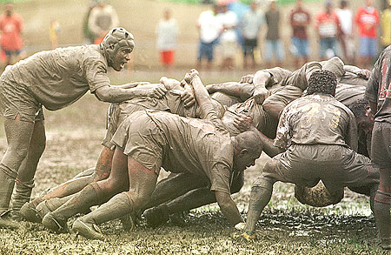
Team Management
Scrum Methodology
Releases
Sprints
Daily Scrums
  What have I done since last Scrum?
  What am I planning to do next?
  Any impediments?
Scrum Master(s)

Slide 6


Goals of the Project
Communication with Customer
Different points of view may cause...
Always involve Customer
User requirements
System requirements
No over specification
Notes:
Sept 2010

Slide 7



Goals of the Project
Main Requirements
Universal workflow tool
Efficient recovery mechanism
Versatile data format (XML)
Multi-platform software
Strongly interactive system
Security and safeness

Slide 8
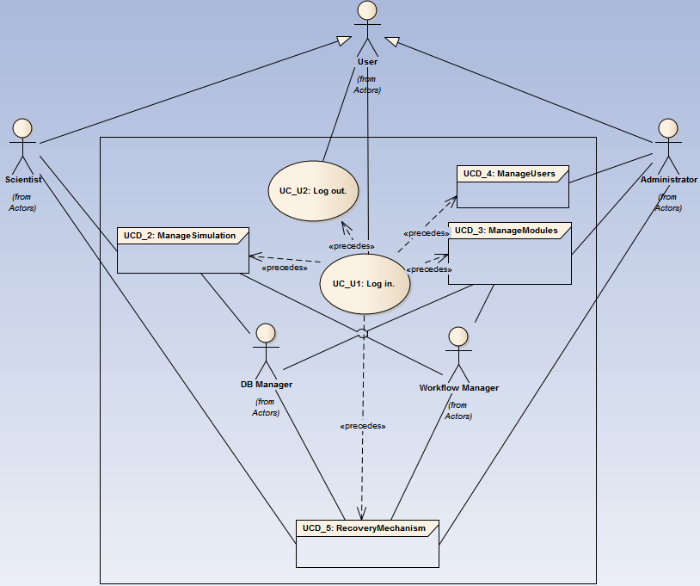
Goals of the Project
Use Case Diagram of the System

Slide 9
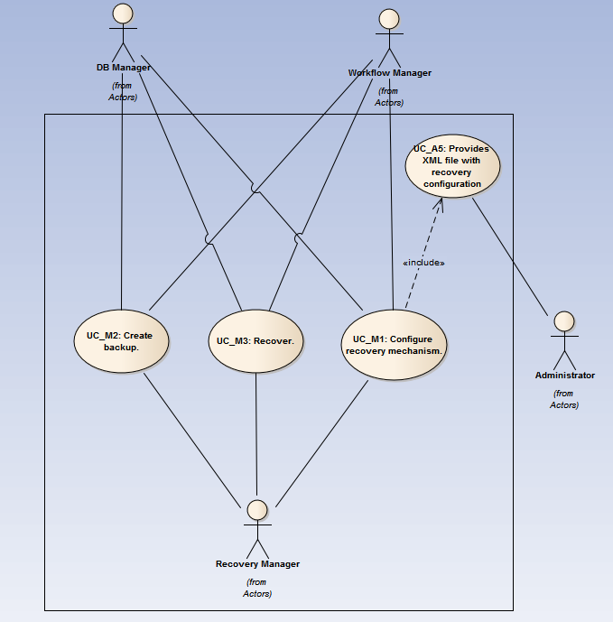
Goals of the Project
Use Case Diagram of the Recovery Mechanism

Slide 10
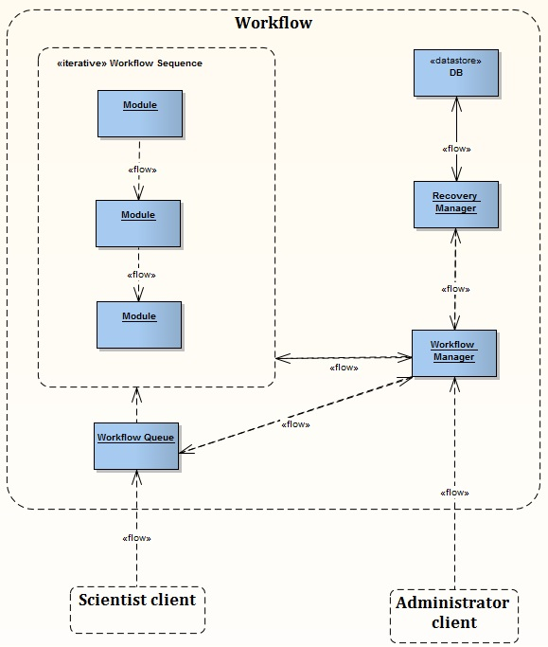
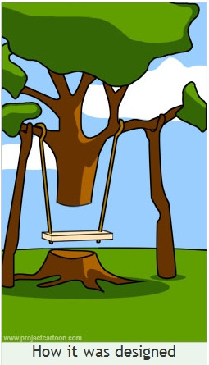
Design of the Project
System Architecture
Client – Server
Workflow
Scientist client
Administrator client

Slide 11
Design of the Project
Workflow Patterns perspectives
Sequential Workflow
Task Data
Automatic execution
Recovery action
Control Flow Pattern
Data Pattern
Resource Pattern
Exception handling
pattern

Slide 12
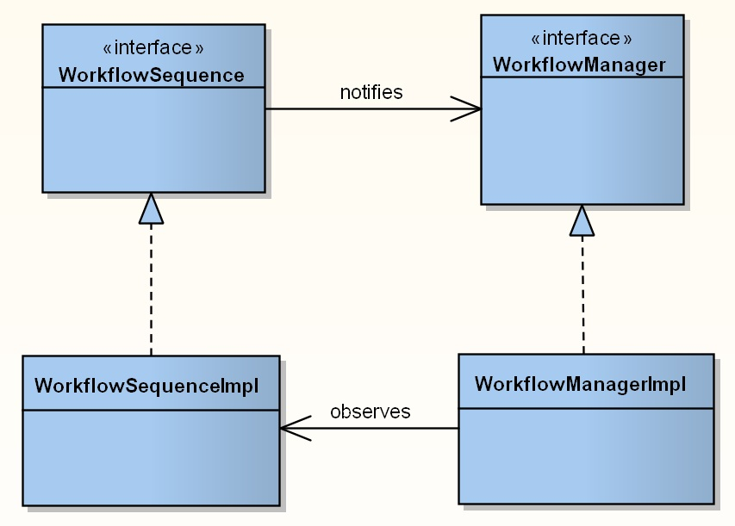
Design of the Project
Behavioural pattern
Observer

Slide 13

Design of the Project
Backup policy
Stable points based
Module dependent
Dynamic
Configurable

Slide 14

Design of the Project
Recovery mechanism
Stable points driven
Configurable
Strategy
last stable point
previous stable points
failure actions

Slide 15
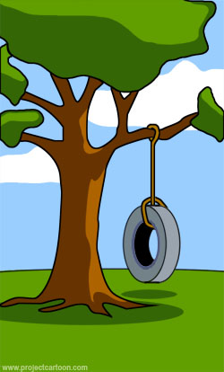
Testing Strategy
Requirement Test
Start early
Functional requirement test
be clear
be consistent
clarify assumptions
discover missing requirements
Non-functional requirements
concrete values
What the customer really needed
Notes:
It is very important to find faults and misunderstandings at the early stage of a software development project as soon as possible.
Many projects fail because of the misinterpreted requirements. => Very important to clarify the requirements with the customer.
It should be clear for a designer or a programmer, who read it at the first time, and doesn’t know the aims of the project.
We had many assumptions at the beginning of the project, and we tried to discover them day by day. We contacted with the customer and clarified these assumptions.
We read and reviewed the given document many times to clarify missing and hidden requirements.
Non-functional requirements:
- number of parallel users
- supported operating systems
Testing:
Compatibility testing (network, operating system)
Performance testing
Security testing
Sept 2010

Slide 16
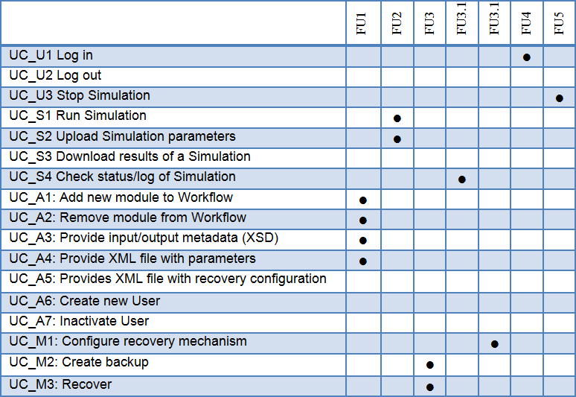
Testing Strategy
Preparing Acceptance Test
Trace-ability Matrix for use-cases
Notes:
The acceptance test should be executed at the end of the project, but it is recommended to start the preparations at the beginning.
After we had produced the requirements we have created the use-cases using the UML.
The Trace-ability Matrix is a good practice to check that is all the functional requirements are covered by use-cases.
The Trace-ability Matrix is very usual tool to follow the requirements changes. By using them, it is easy to see which use-case should be changed.
Sept 2010

Slide 17
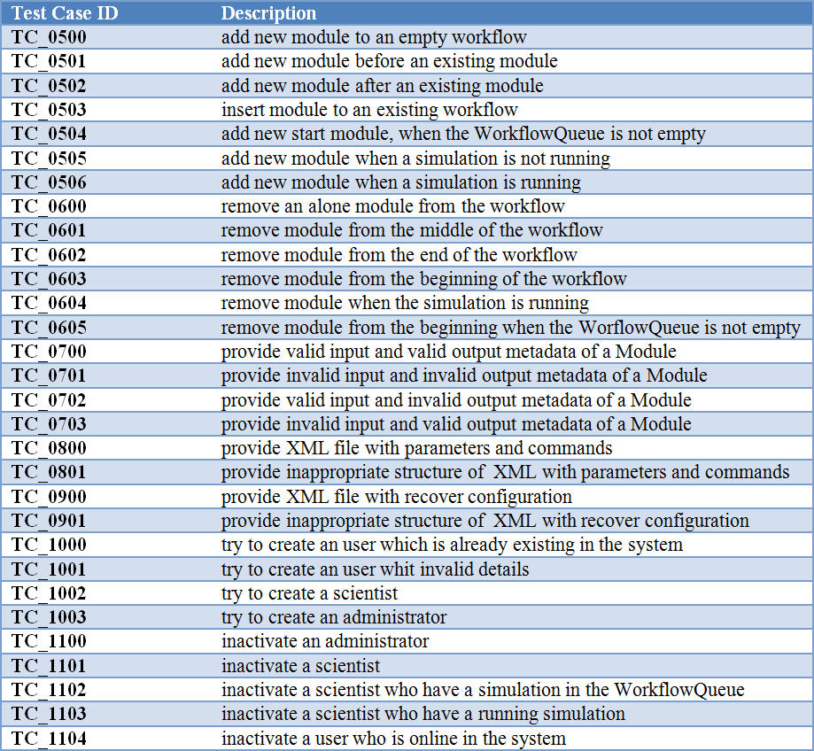

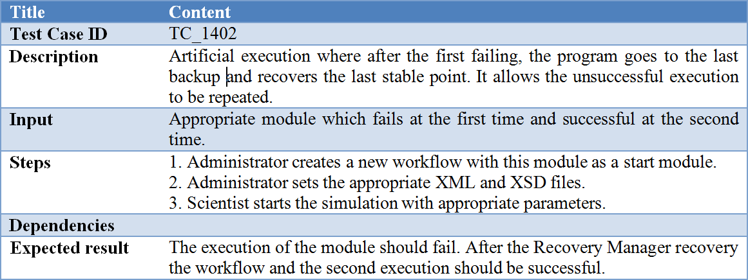
Testing Strategy
Test Cases
How it was tested
Notes:
We created test cases to test the correctness of each operation and to examine how they affect each other.
We made many test case variants for each operation to reach better test coverage.
We chose the following form to describe each test case.
Sept 2010

Slide 18
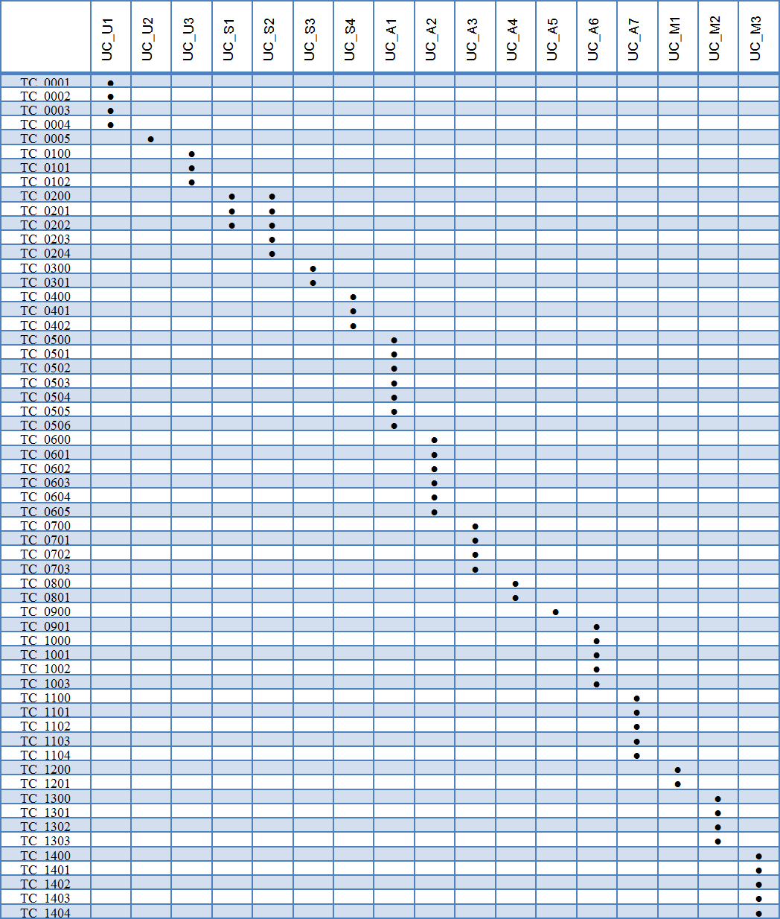
Testing Strategy
Trace-ability Matrix for test-cases
Notes:
The Trace-ability Matrix is also usable to check that at least one test-case exists for every use-cases.
The columns contain the use-cases, while the rows contain the test-cases. When a test-case connects with a use-case, we sign it with a dot.
Sept 2010

Slide 19
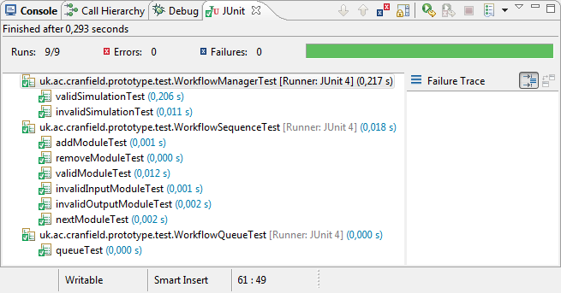

Testing Strategy
Unit test
Integration test
Unit test
Junit
Integration test
JUnit
Mocks
Scenarios
How it performed under
load test
Notes:
We choose the Java programing language for the implementing our system. JUnit is an easy to use environment for Java, to create repeatable tests.
So it was convenient to choose the JUnit as a testing environment. We planned to create JUnit testes for every unit and component.
Integration test
JUnit is not limited for unit tests, so we decided to use JUnit where it is a possible in the system.
Many mock classes have been created to ensure the excitability of the prototype. Furthermore these mock classes are very important to execute the unit testes.
We plan to test the bigger components of the application, and examine how they work together.
The modules which we plan to test in the integration test:
WorkflowManager / RecoveryManager / WorkflowSequence
A few scenarios what we plan to examine:
The Workflow gets knowledge about the unsuccessful execution. It asks the RecoveryManager to get the last stable point, who forwards it to Database Manager. Finally the WorkflowManager should get the last backup from the DatabaseManager through the RecoveryManager.
After a successfully execution, if the RecoveryManager decide to store the result it sends it to the DatabaseManager and the backup will be store in the database.
Sept 2010

Slide 20

Implementation
THE TECHNOLOGIES USED
Decision-making principles:
Wide applicability
Large customer base
= Multi-platform availability
The most appropriate choice for this purpose:
JAVA - programming language
SSH protocol – for communication

Slide 21
Implementation
MULTI-PLATFORM BEHAVIOUR
JAVA:
Ideally, this means Java can be developed on any device,
compiled into a standard bytecode and be expected to run
on any device equipped with a Java .virtual machine (JVM).
SSH:
Can be used for many applications across many platforms (i.e. Windows, Linux, Mac).
The SSH Server runs on UNIX, Linux and VAX. Client runs on the above, plus Windows
and many other platforms.

Slide 22
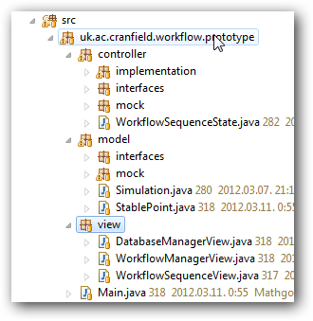
Implementation
Implementation
STRUCTURE OF THE PROGRAM
Features:
Just a PROTOTYPE
Not implemented all the components
The program is well-structured.
/ Model View Controller pattern /

Slide 23
Implementation
STRUCTURE OF THE PROGRAM
Implemented modules:
Recovery function of the system
(WorkflowManager, WorkflowQueue and WorkflowSequence classes)
Environment
Special components (called MOCK) generate
the appropiate environment for adequate running
Implemented scenarios
Workflow execution success
Workflow execution failure, recovery succes
Workflow execution failure, recovery failure

Slide 24
Demonstration
http://code.google.com/p/applications-in-high-end-computing/source/browse/trunk/Presentation/FINAL.avi

Slide 25
Costs
Costs of finished work
Activity\Dimension | Hours: | Hour's cost: | Total cost:
Requirement Analysis | 72 | £60.00 | £4,320.00
Software Design | 64 | £60.00 | £3,840.00
Software Development | 51 | £40.00 | £2,040.00
Quality Assurance | 51 | £30.00 | £1,530.00
Project Management | 34 | £80.00 | £2,720.00

Slide 26
Costs
Costs forecasting - "how much to finish"
Activity\Dimension | Hours: | Hour's cost: | Total cost:
Requirement Analysis | 160 | £60.00 | £9,600.00
Software Design | 480 | £60.00 | £28,800.00
Software Development | 1920 | £40.00 | £76,800.00
Quality Assurance | 800 | £30.00 | £24,000.00
Project Management | 640 | £80.00 | £51,200.00

Slide 27
Costs
And the magic number is:
Total cost of the project is:
£204,850.00
If customer would decide to accept offer immediately and would pay by cash we can give them discount, so that final cost would decrease to just:
£200,000.00
This is one of this moments where words are simply not enough.

Slide 28

Question?

Slide 29
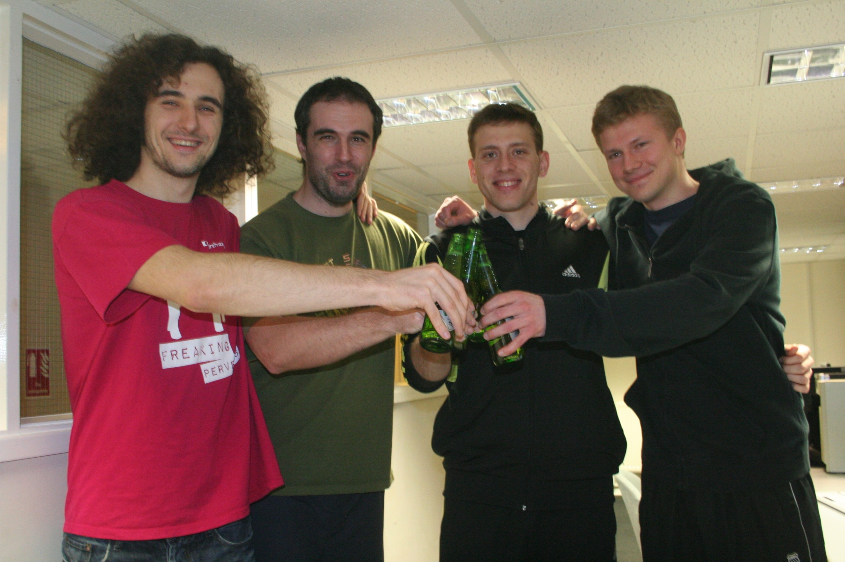
Thank you for your attention

